Slide 1
TIMECLOCK AND PAYROLL
A clock punch becomes
the hours on payroll.
About 10 minutes. One sample driver, one day, from the Timeclock to the payroll file.
Practice office. Donald Duck on route S9 is a sample, not a real employee.
Notes:
Open with the one idea. We follow one sample driver, Donald Duck, on route S9, through the practice office. These names are not real employees.
A punch on the Timeclock stays on the minute it was tapped. Payroll then uses the nearest quarter hour. That is the whole talk.

Slide 2
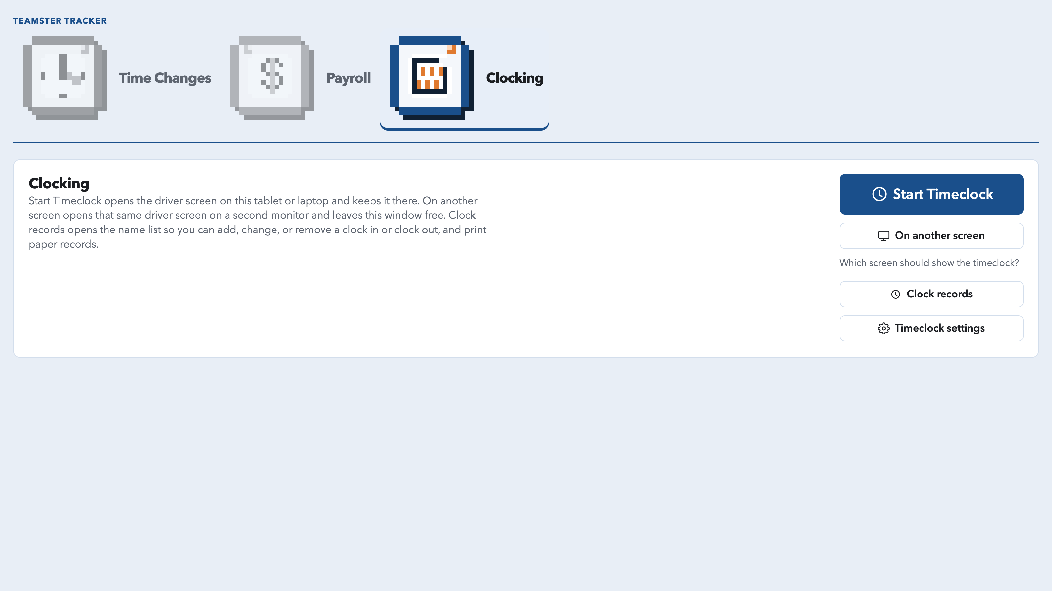
Start Timeclock and leave the driver screen up.
2 of 8
Notes:
This is Clocking.
Start Timeclock opens the driver screen on this tablet or laptop and keeps it there. On another screen puts that same screen on a second monitor and leaves this window free.
Clock records is where the office adds, changes, or removes a clock in or clock out, and prints paper records.
For the next minute we are on the driver screen.

Slide 3
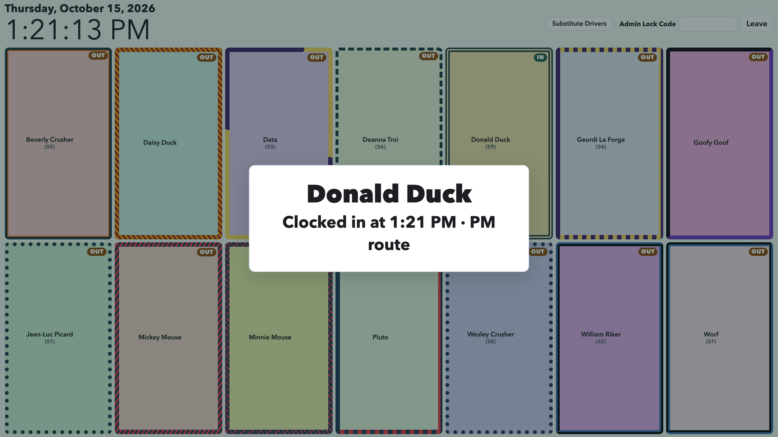
The punch keeps the minute it was tapped.
3 of 8
Notes:
Donald tapped the PM run. The card says he clocked in at 1:21 PM for the PM route.
That is the real minute. The Timeclock does not round it. His name turns to IN, so the office can see who is still clocked out.
Payroll rounding happens later. It does not change the time on this card.

Slide 4
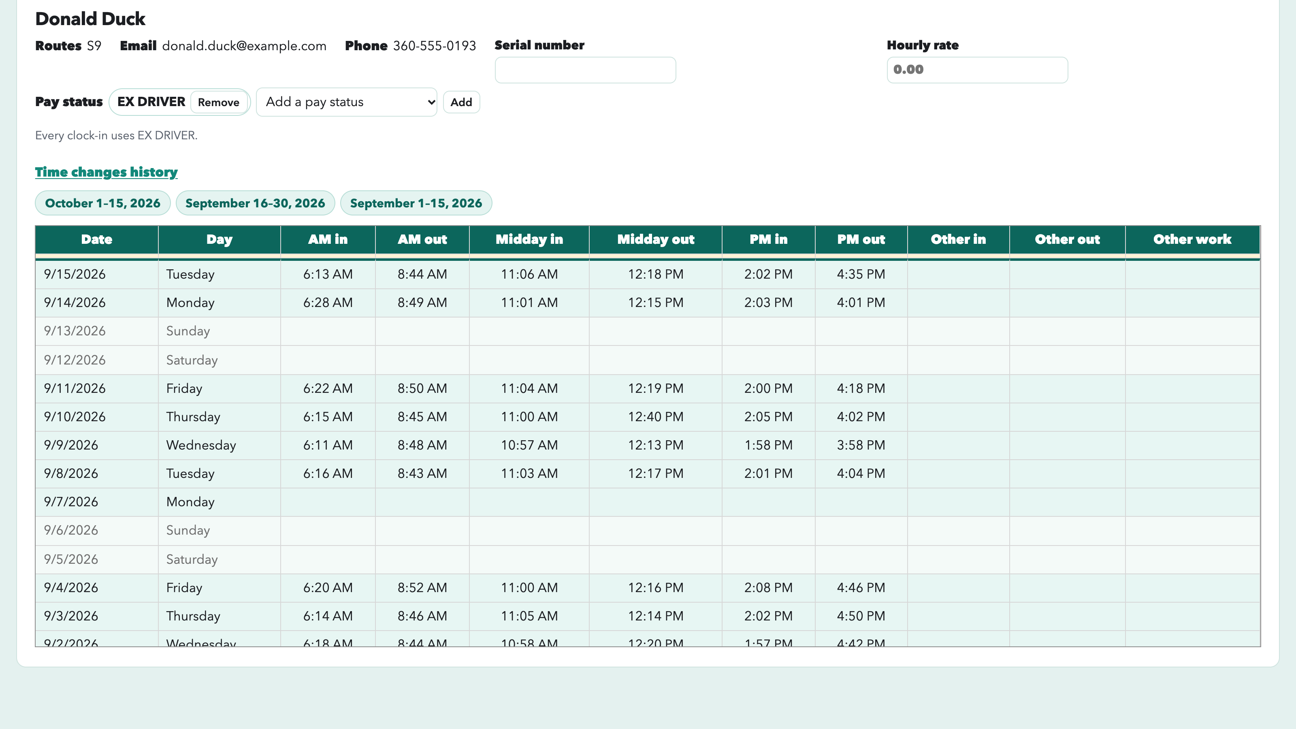
Clock records keep each day’s actual times.
4 of 8
Notes:
After the clock out, the day is on the clock record. These are still the actual minutes.
Follow Tuesday, September 15. That is Donald’s latest completed day.
AM is 6:13 to 8:44. Midday is 11:06 to 12:18. PM is 2:02 to 4:35.
Nothing on this sheet is rounded. We take this one day into Payroll.

Slide 5
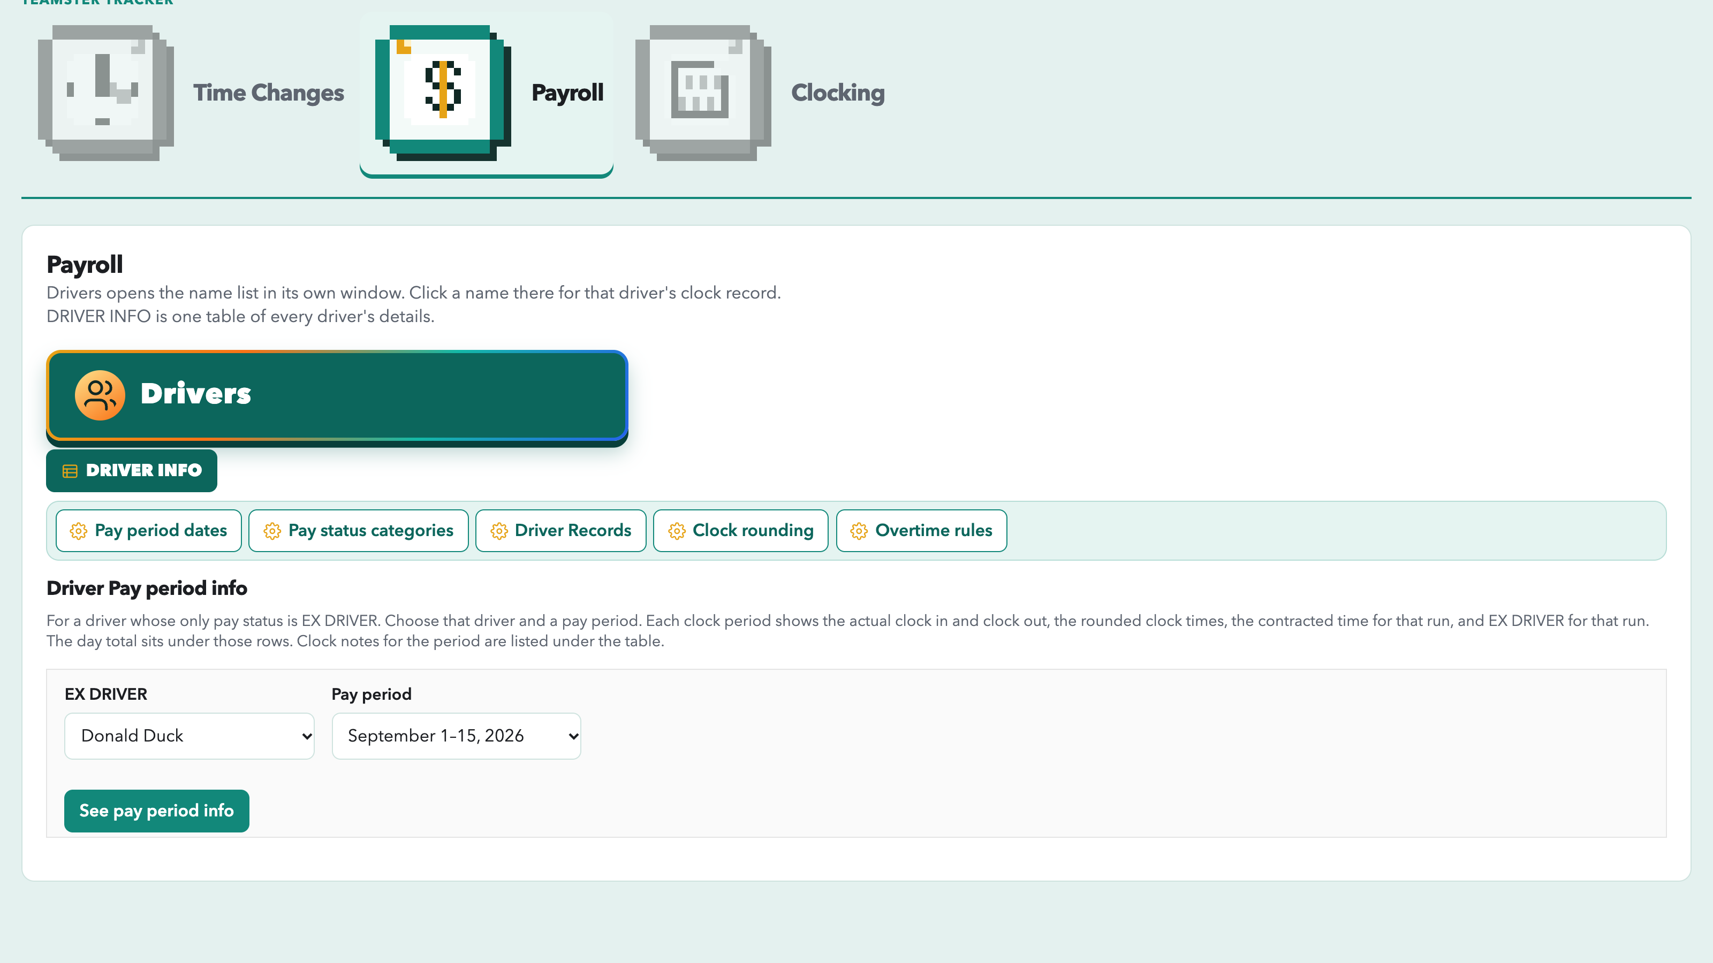
On Payroll, open that driver’s pay period.
5 of 8
Notes:
Open Payroll, then Driver Pay period info.
This list is drivers whose only pay status is EX DRIVER. Donald is one of them.
Choose Donald Duck and September 1 through 15, then See pay period info.
That opens the sheet where the punches and the quarter hours sit on the same page.

Slide 6
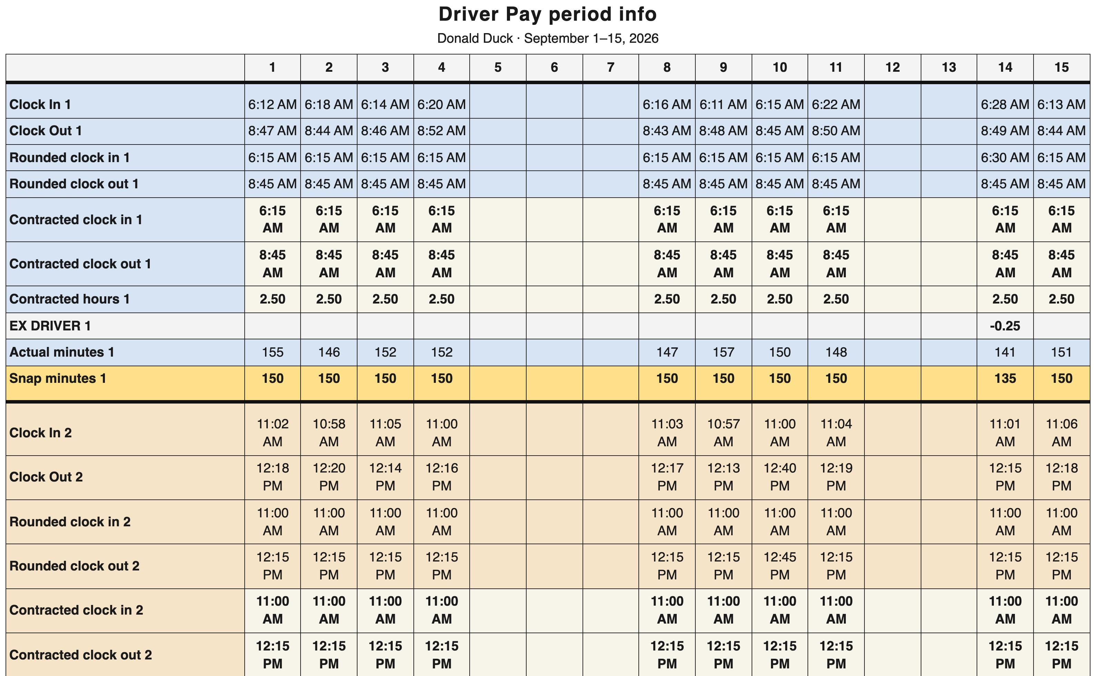
The same punches sit next to the quarter hour.
6 of 8
Notes:
This is September 1 through 15 for Donald.
The Clock In row is the minute he punched. On the 1st, AM clock in is 6:12. Rounded clock in is 6:15. On the 15th, the day from the clock record, AM clock in is 6:13, and that also rounds to 6:15. Clock out 8:44 becomes 8:45.
The yellow Snap minutes row is the time that gets counted. On the 15th, 151 minutes becomes 150. That is 2.5 hours.
The contracted row underneath is the route’s contracted clock, already on a quarter hour.

Slide 7
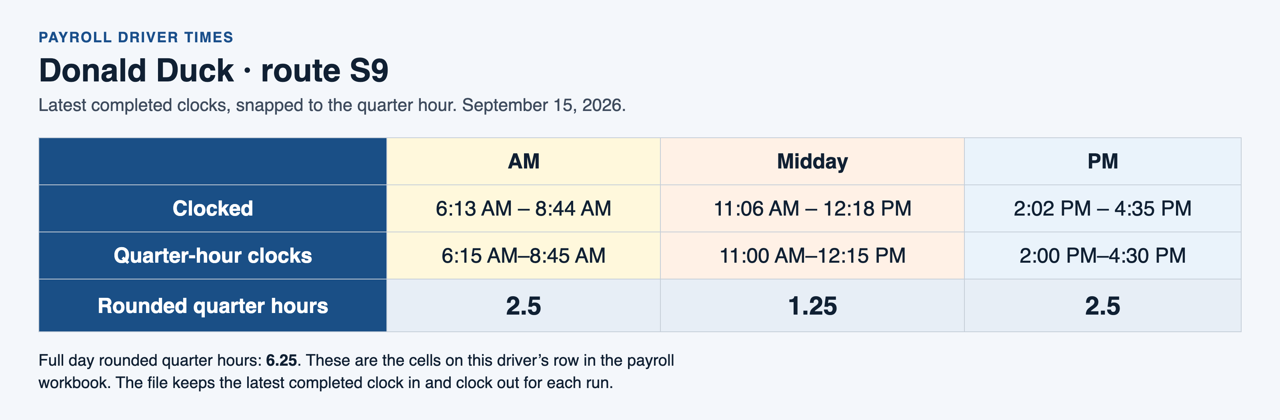
Payroll Driver Times keeps the latest clocks, on the quarter hour.
7 of 8
Notes:
The payroll workbook does not add up every day in the pay period. It keeps the latest completed clock in and clock out for each run, then snaps those times to the quarter hour.
For Donald, that latest day is September 15, the same day on the clock record.
AM 6:13 to 8:44 becomes 6:15 to 8:45, which is 2.5 hours. Midday 11:06 to 12:18 becomes 11:00 to 12:15, which is 1.25. PM 2:02 to 4:35 becomes 2:00 to 4:30, which is 2.5.
The full day is 6.25 quarter hours.

Slide 8
One punch, then the quarter hour.
The Timeclock keeps the minute that was tapped.
Pay period info shows that minute beside the quarter hour.
Payroll Driver Times keeps the latest clocks, already on the quarter hour.
Questions.
Notes:
Close on the three steps, then stop.
The Timeclock keeps the minute. Pay period info shows that minute beside the quarter hour. The payroll file keeps the latest clocks, already on the quarter hour.
Leave the rest of the time for questions. Overtime rules, substitutes, and settings can wait for another conversation.

